Slide 1
How the Net Neutrality argument was won

Slide 2
1. Principle before laws (or technical standards)

Slide 3
Non-discrimination Free Speech Freedom to Tinker Equality Openness Commons Fair Competition Darwinian Innovation Decentralization

Slide 4
Reverse Brand X Sec. 201(a) Carterfone NPRM TCP/IP BGP etc.

Slide 5
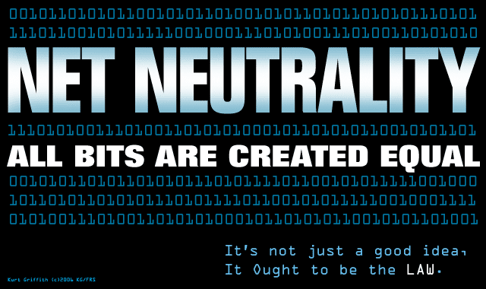

Slide 6
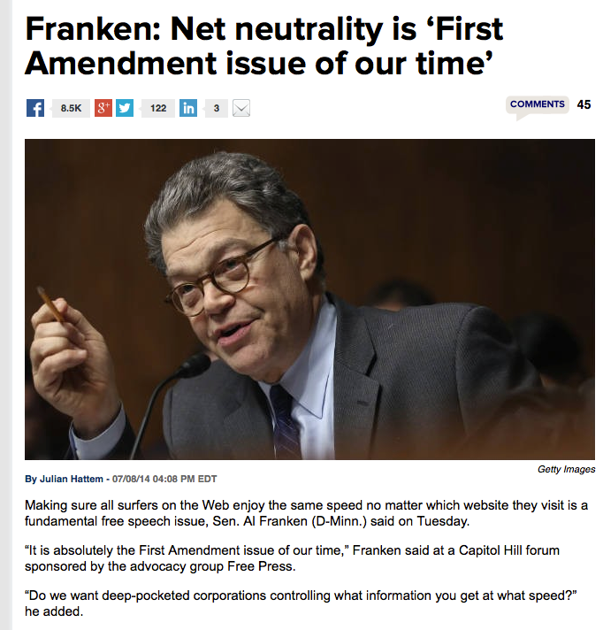

Slide 7
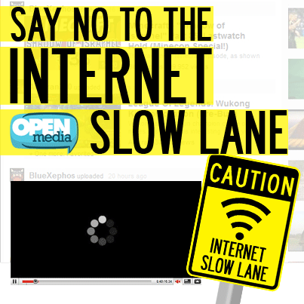

Slide 8
2. Preservation, not action “Most true revolution is styled as a counter-revolution.”

Slide 9
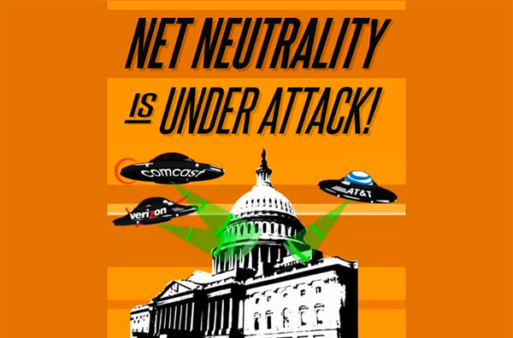

Slide 11
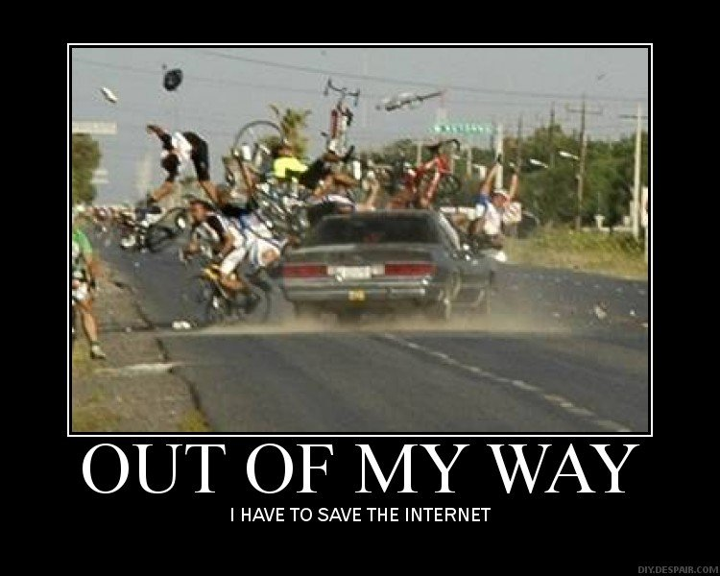

Slide 14
3. A Reaction to wrongs with “Thou shall not” rules

Slide 15
AT&T DSL conditions of use (2002): [Subscriber may not] run programs, equipment or servers from the Premises which provide network content or any other services to anyone outside of the your home . . . . Examples of prohibited programs and equipment include, but are not limited to, mail, ftp, http, file sharing, game, newsgroup, proxy, IRC servers, multi-user interactive forums and Wi-Fi devices.

Slide 16
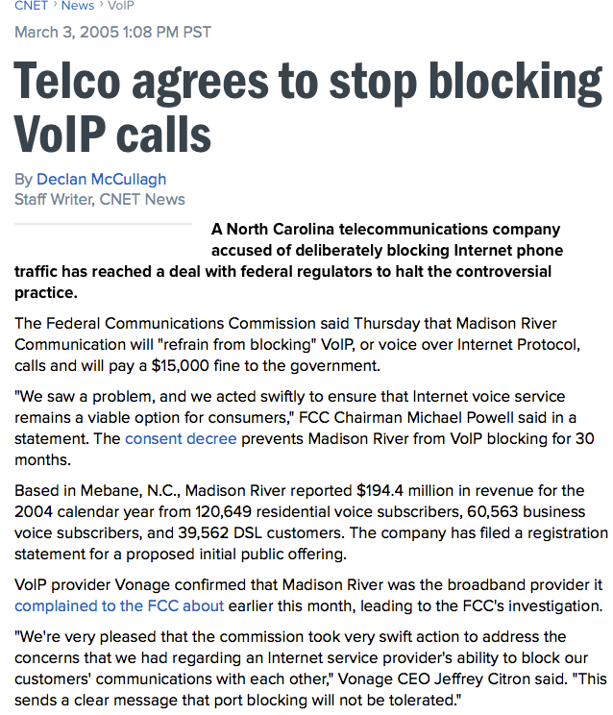

Slide 17
4. Good labels and flexibility “No one disagrees with Ne Neutrality per se”

Slide 18
Inter-Network Neutrality
End-to-End design
The Stupid Network
Dumb Pipe
Network Freedoms
Open Internet Rules

Slide 19
5. Failure of Competing Vision

Slide 20
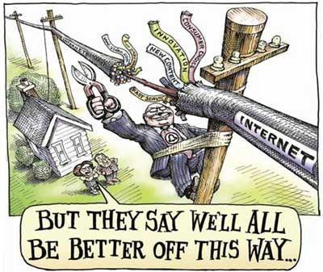

Slide 21
Incentives to deploy “Telemedicine” Smart Pipes Network Differentiation “Solution looking for a problem” “Obamacare for the Internet”

Slide 22
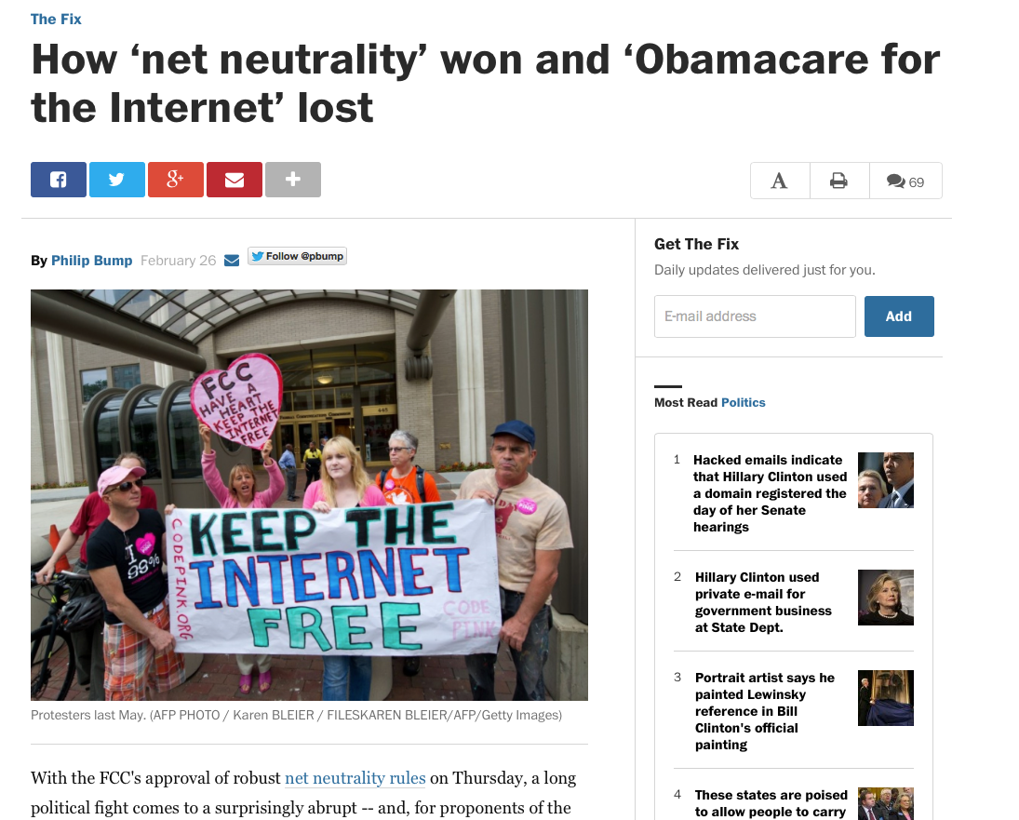

Slide 23
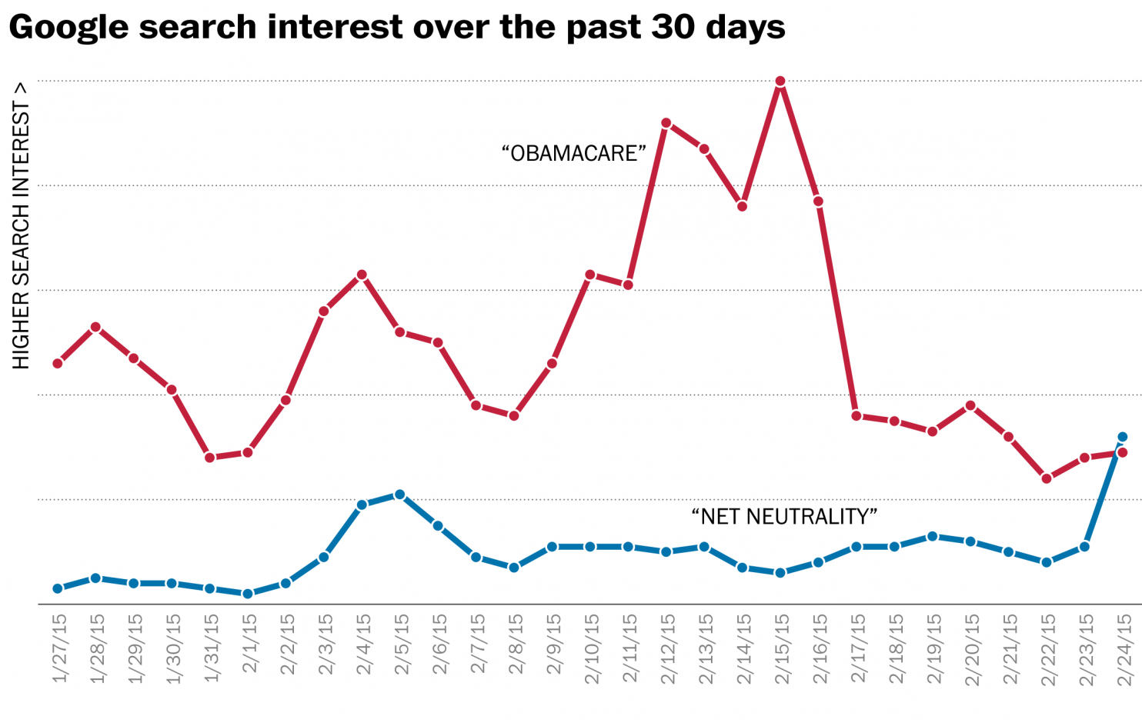

Slide 24
